Slide 1
Global Challenge of Employee Competence
Ronald L. Jacobs, PhD
University of Illinois
November 2013

Slide 2


Slide 3
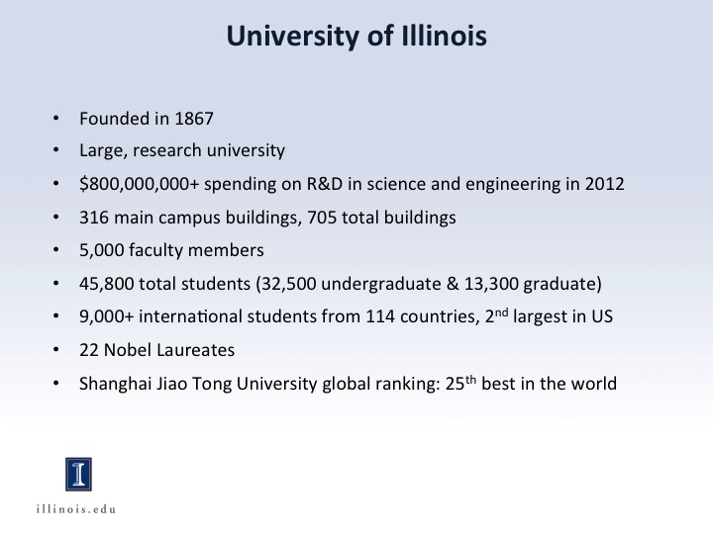

Slide 4
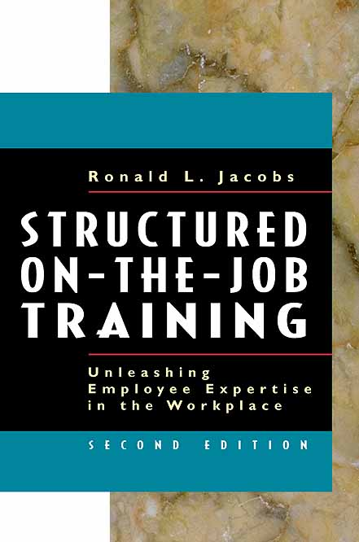

4
Copyright Ronald L. Jacobs (2013)

Slide 5


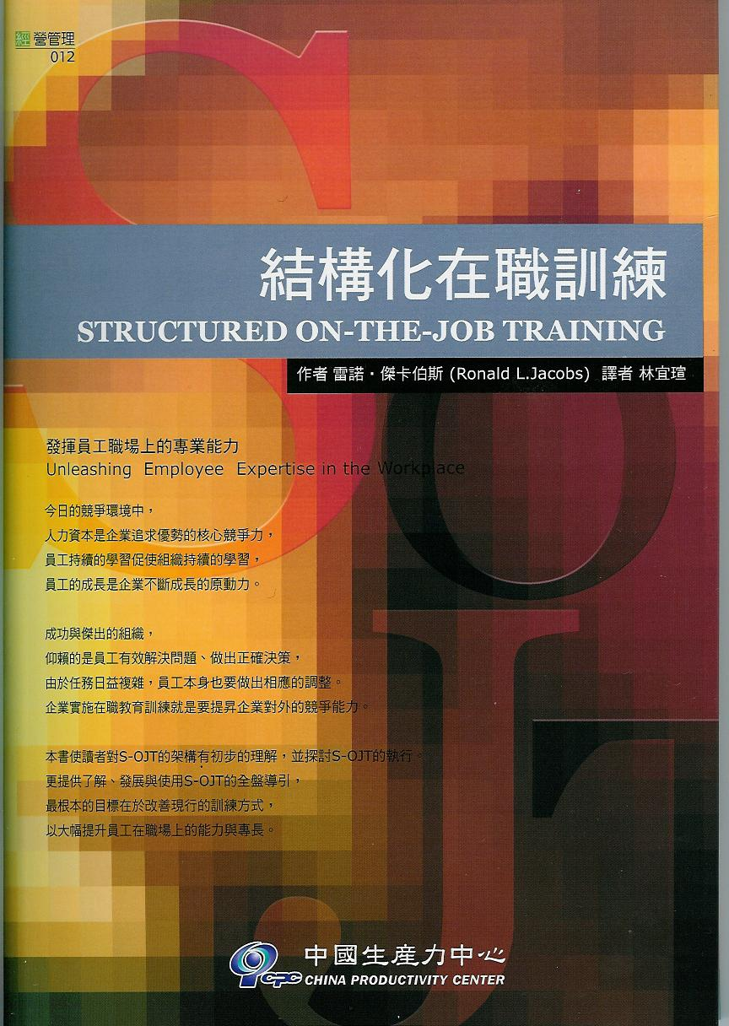
5
Copyright Ronald L. Jacobs (2013)

Slide 6
Context
Human Resource Development is the process of improving organizational performance and learning through the accomplishments that result from employee development, organization development, and career development programs.

Slide 7
Context
Employee Development – training and educational programs that provide individuals with the competence to meet current work expectations.
Organization Development – human and structural change to facilitate improvement, innovation, and transformation among individuals, processes, and organizations.
Career Development – educational and experiential programs to match the needs of organizations and the interests of individuals.

Slide 8
Context
HRD is a major business process.
Something organizations must do
HRD benefits both the organization and individuals. As a major business process, it serves customers to achieve outputs of value.

Slide 9
Employee Competence
Global Organizational Issue . . .
Employee Competence – the relative ability to perform specific areas of work

Slide 10
Employee Competence
Competence – The relative ability to perform a set of work
Competency – The underlying dimensions required to perform successfully

Slide 11
Employee Competence
Category | Description
Master | The real expert among experts, teaches others, shares new knowledge
Expert | One who can do both the routine and non-routine instances of the work
Experienced Specialist | One who has performed the work repeatedly and can do it with ease
Specialist | One who can perform the work, but the range is limited
Novice | One who is new to the work and lacks the ability to perform
Jacobs, 2002

Slide 12
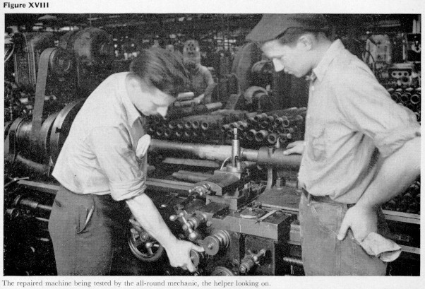
Employee Competence: Important then and now.

Slide 13
Machine Tool Operator
Expert
Experienced
Specialist
Manual controls
Specialist
Novice
1940
1950
1960
1970
1980

Slide 14
Hand controls, hand tools
Numerical controls, hand tools
Computer Numerical Control (CNC)
CNC – Linked cells
Advanced cutting tools
Parametric programming
Flexible programming
Machine Tool Operator
Expert
2
Experienced
Specialist
3
Learning Curve
4
5
6
7
1
Specialist
Novice
1980
1985
1990
1995
2000
2008
Jacobs (2003); Boulay & Jacobs (2005)

Slide 15

Hospital Nurse
Expert
Experienced
Specialist
Patient Care-Giver
Specialist
Novice
1940
1950
1960
1970
1980

Slide 16
Hospital Nurse
Patient care-giver
Expanded Job
Documentation
Patient Education
Infection control
Technology
Expert
2. Expanded Job
3. Documentation
4. Patient Education
Experienced
Specialist
5. Infection control
Learning Curve
6. Technology
1. Patient Care-Giver
Specialist
Novice
1980
1985
1990
1995
2000
2008
Jacobs (2003); Boulay & Jacobs (2005)

Slide 17
The Issue: Employee Competence
“Organizations must transform themselves to become
more competitive, and the know-how of employees has
become more critical for ensuring the success of the
transformation process.”
New-hires: Full-time, Part-time, Temporary
Promotion
Rotation and transfer
Continuous improvement efforts
Multi-skilled employees
Technology
Nature of work
Regulated environments

Slide 18

New production equipment arriving from Jacksonville, Florida at Biomet Orthopedics, Jinghua, China, 2008.

Slide 19
Structured On-the-Job Training (S-OJT)
S-OJT is the planned process of having an experienced employee train a novice employee on a task in the actual work setting or a setting that resembles the work setting.

Slide 20
S-OJT Components
Task – A specific unit of work, a task. Not the entire job
Planned Process –
Use a process to develop the S-OJT
Deliver the S-OJT using a standard approach
3. Experienced Employee –
Knows the task
Has been qualified as an S-OJT trainer
4. Novice Employee –
Right person to learn
Has the prerequisites
Ready to learn
5. Work setting – Working and training occur in the same or similar location

Slide 21
Quality Management Systems
ISO 9001
ISO 14000
TS2 – Automotive Standard
ISO 10015
Supplier Development Requirements
HondaSupplyTeam
Governmental/NGO Requirements
FDA
OHSHA
EU standards
Risk and liability insurance

Slide 22
S-OJT Cases
Company | Issue | Outcomes
KNPC – Kuwait | New-hire engineers for 31 disciplines in refineries | Reduced development time; increase reliability, flexibility, retention
City Hospital- U.S. | Recently promoted first-line supervisors’ commitment to the organization’s four core value | More commitment to the organization’s core value
Automotive Plant- U.S. | Quality issue in a large assembly plant | Improved training efficiency and product quality
Honda Motors | Cross-train employees on sub-assembly areas | Fewer assembly errors and reduced time to train new employees
Emerson – Global | Sustain improvements used with Kaizen process | Reduced time to implement improvements
Biomet | Meet FDA requirements Reduce material waste | FDA acceptance of S-OJT 35% reduction of waste
Large furniture retailer in US | New-hire managerial positions across 140 stores | Improved selection policies, reliable development process, retention, profitability

Slide 23
S-OJT Process
1. Decide when to use S-OJT
2. Analyze the tasks
3. Develop the trainers
5. Deliver the S-OJT
6. Evaluate the S-OJT
4. Prepare the S-OJT module

Slide 24
Importance of S-OJT
Over two decades of research and development* show that . . .
S-OJT results in . . .
Reduced training times
Increased training effectiveness
Which lead to . . .
Fewer defects
Greater first-time quality
Fewer safety issues
Higher productivity
Greater satisfaction, retention
*Jacobs (2003)

Slide 25
6. Evaluate the S-OJT
Training Efficiency - Does one training approach achieve training outcomes faster, and is the cost less than the value of the training outcomes?
Training Effectiveness - Does one training approach result in superior work outcomes, and is the training cost less than the value of the work outcomes?

Slide 26
6. Evaluate the S-OJT
Training Efficiency
Unstructured OJT
S-OJT
Savings in Time
Specialist
Performance
Level
Novice
Time to Learn

Slide 27
6. Evaluate the S-OJT
Training Effectiveness
Employee learns through unstructured OJT
Employee learns through S-OJT
Employee completes work Employee completes work
Measure performance Measure performance
Outcomes compared

Slide 28
6. Evaluate the S-OJT
Training Effectiveness
Employee learns through
unstructured OJT
Employee learns through
S-OJT
Unit of work
Truck windshields installed
Sales calls made
Machinery on-line
Hard disks manufactured
Consequences
Fewer reworked windshields
Higher sales volume
Higher machine productivity
Lowered scrap rate

Slide 29
Thank you!
Ronald L. Jacobs
Professor and Coordinator, Human Resource Development
Director, Office of International Programs
University of Illinois
Email: rljacobs@illinois.edu
Homepage: http://education.illinois.edu/frp/j/rljacobs

